Slide 1
Large Language Model Fundamentals
Jun Liang
2025/01/12

Slide 2
Motivation
Make the audience understand the essence of artificial intelligence including LLMs.
Share helpful information/tips on how to learn and use LLMs.

Slide 3
Agenda
Artificial Intelligence (AI)
IR 4.0
What is AI?
Large Language Model (LLM)
What is LLM?
LLM Key Features
Scalability
Scaling Laws
Prompt Engineering
Usability
Retrieval Augmented Generation (RAG)
AI Agent
LLM Training
Fine-tuning, Parameter Efficient Fine Tuning (PEFT)
LLM Evaluation
Tips

Slide 4
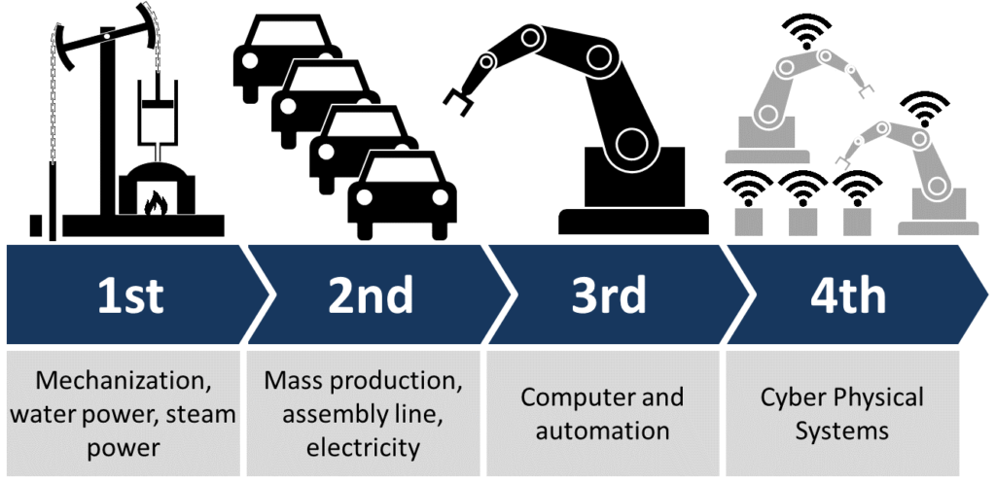
Industry Revolution (IR)
Four phases in IR
IR1.0 (18th century to the Middle of 19th century)
IR 2.0 (the late 19th century to the early 20th century)
IR 3.0 (the late 20th century to about 2015)
IR 4.0 (about 2015 ~)
Source:
https://en.wikipedia.org/wiki/Industrial_Revolution
https://en.wikipedia.org/wiki/Fourth_Industrial_Revolution
https://www.renaix.com/industry-4-0-the-fourth-industrial-revolution/

Slide 5
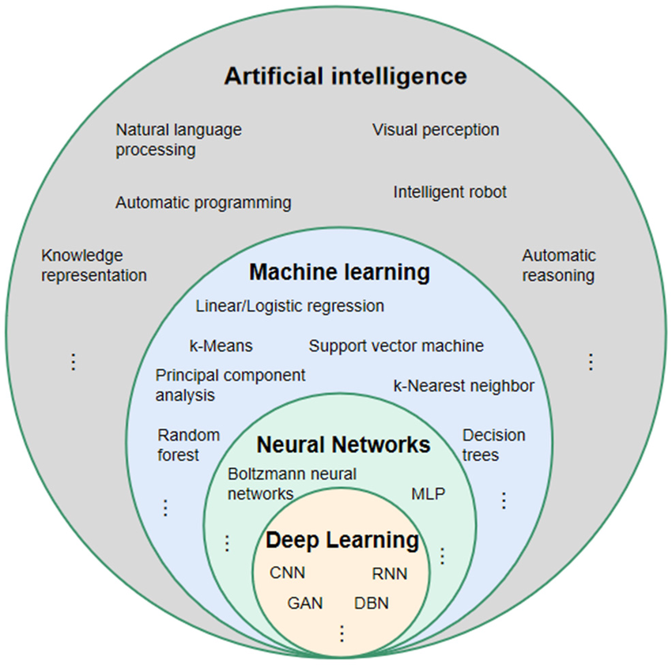
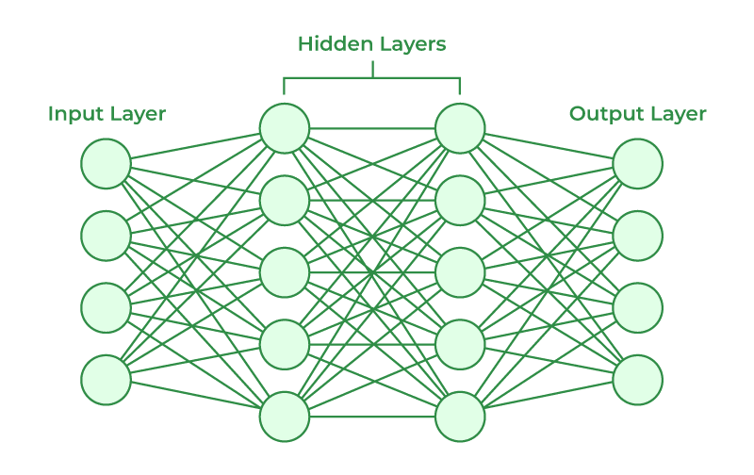
What is AI?
A field that includes machine learning and neural networks.
Machine Learning (ML)
A subset of AI that includes neural networks. Has strong background on programming, algorithm development, statistical methodologies, and big data analytics.
Compared to deep learning, some people call it shallow machine learning.
Neural Network (NN)/Artificial Neural Network (ANN)
A technique to process data in a way that mimics the human brain. Neural networks can learn from experience and identify patterns in data.
Multi-layer perceptron (MLP)
Fully connected/Dense layer feedforward networks: Each node connects to all nodes in the next layer.
At least three layers of nodes: An input layer, one or more hidden layers, and an output layer.
Non-linear Activation function: to learn more complex patterns that are not possible with a purely linear model.
Deep learning
More than tens or even hundreds layers
More complicated structures to enhance the problems of neural networks
Relationship between artificial intelligence, machine learning, neural network, and deep learning.
(MLP: multi-layer perception/preceptron; CNN: convolutional neural network; RNN: recurrent neural network; DBN: deep belief network; GAN: generative adversative network)
An example of MLP neural networks architecture
Source: https://www.researchgate.net/figure/Relationship-between-artificial-intelligence-machine-learning-neural-network-and-deep_fig3_354124420

Slide 6
Wrap up
Concept
Artificial Intelligence
Creating intelligent machines to mimic human brains/intelligence.
Machine Learning
Finding algorithms to enable computers to learn from data. Especially, finding the rules of data.
Neural Network
Computational models with interconnected artificial neurons.
Deep Learning
Neural networks with more and deeper layers of hierarchical representation of learning.
Relation
Deep learning is a subfield of machine learning which uses artificial neural networks to enable artificial intelligence systems to learn complex patterns/regularities from data.

Slide 7
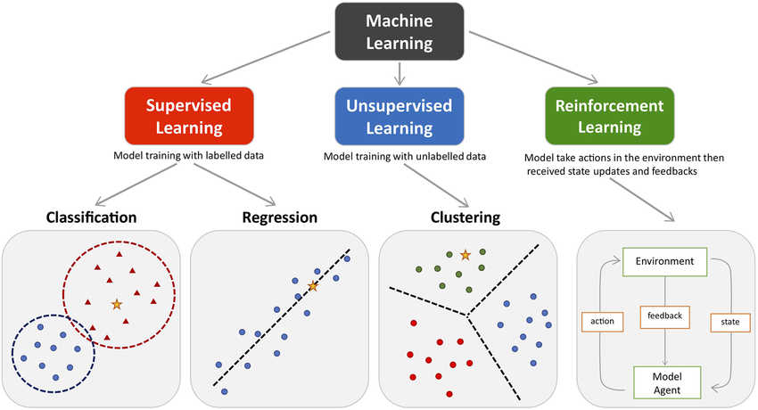
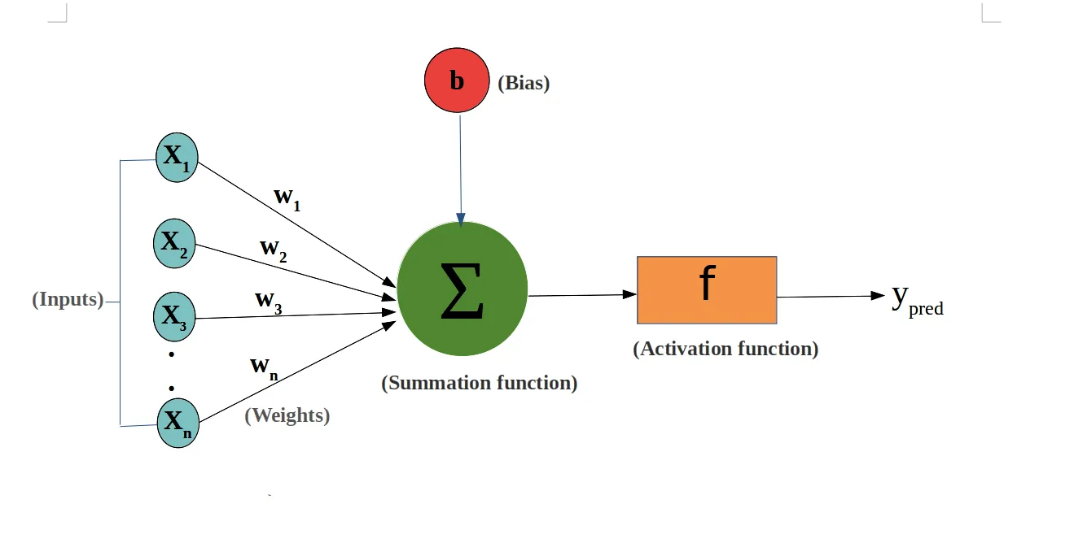
Machine Learning and Neural Network
The three main types of machine learning.
Linear Regression
Non-linear Regression
Result Prediction
The learning process of Regression in neural network
Classification involves predicting discrete labels (e.g., spam or not spam)
Regression involves through the moving trend of the previous data to predict the next data’s moving trend. The moving trends are continuous values (e.g., house prices).
Identifies groups of similar data points (e.g., Social network analysis).
The agent learns by taking actions in an environment to maximize cumulative reward over time (e.g., AlphaGo).
The three main types of machine learning
Source: https://www.researchgate.net/publication/354960266_Machine_Learning_Techniques_for_Personalised_Medicine_Approaches_in_Immune-Mediated_Chronic_Inflammatory_Diseases_Applications_and_Challenges

Slide 8
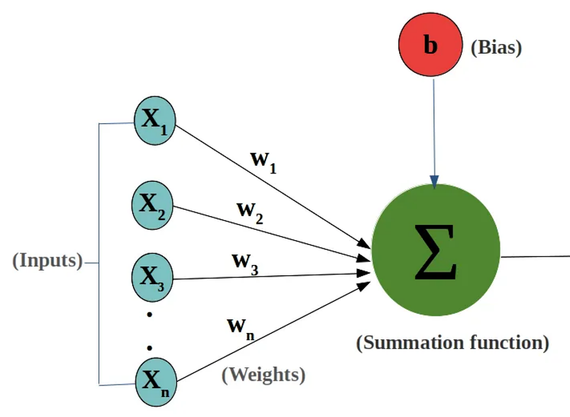
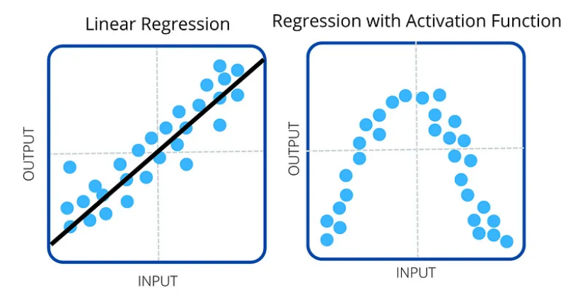
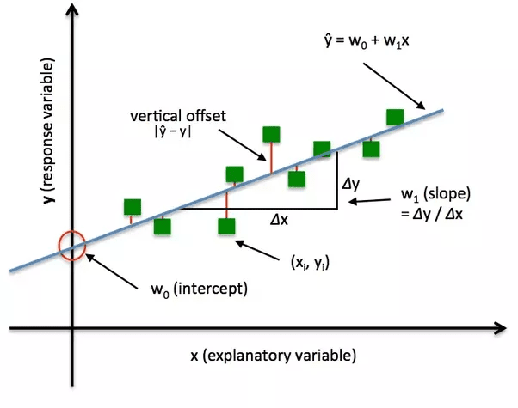
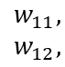
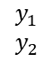
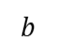
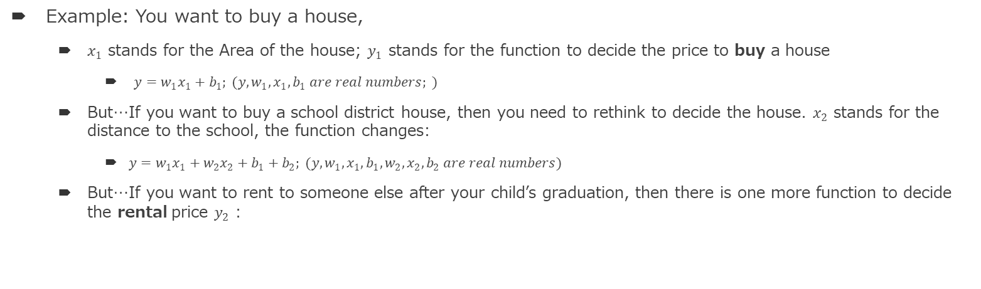
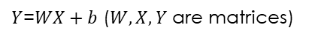
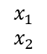
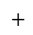
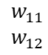
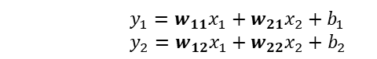
Weights, Bias, Activation function, Loss function in neural network
Weights, Bias
Activation function
Loss function (using back propagation)
Example: You want to buy a house,
$x_{1}$ stands for the Area of the house; $y_{1}$ stands for the function to decide the price to buy a house
$y={w_{1}x}_{1}+b_{1}; (y,w_{1},x_{1}, b_{1} are real numbers; )$
But…If you want to buy a school district house, then you need to rethink to decide the house. $x_{2}$ stands for the distance to the school, the function changes:
$y={w_{1}x}_{1}+{w_{2}x}_{2}+b_{1}+b_{2}; (y,w_{1},x_{1}, b_{1},w_{2},x_{2}, b_{2} are real numbers)$
But…If you want to rent to someone else after your child’s graduation, then there is one more function to decide the rental price $y_{2}$ :
$$y_{1}={w_{11}x}_{1}+{w_{21}x}_{2}+b_{1}$$
$$y_{2}={w_{12}x}_{1}+{w_{22}x}_{2}+b_{2}$$
2-dim
$$\begin{matrix}y_{1} \\ y_{2}\end{matrix}$$
=
$$\begin{matrix}w_{11}, \\ w_{12},\end{matrix}$$
$$\begin{matrix}w_{11} \\ w_{12}\end{matrix}$$
$$\begin{matrix}x_{1} \\ x_{2}\end{matrix}$$
$$+$$
$$b$$
Expand
to N-dim
$Y$=$WX+b$ ($W,X, Y$ are matrices)
2-dimension Matrix
N-dimension Matrix
Source:
https://towardsdatascience.com/whats-the-role-of-weights-and-bias-in-a-neural-network-4cf7e9888a0f
https://www.datarobot.com/blog/introduction-to-loss-functions/
https://medium.com/@siddak.bath/lets-understand-deep-learning-neural-networks-dcaae3e77725

Slide 9
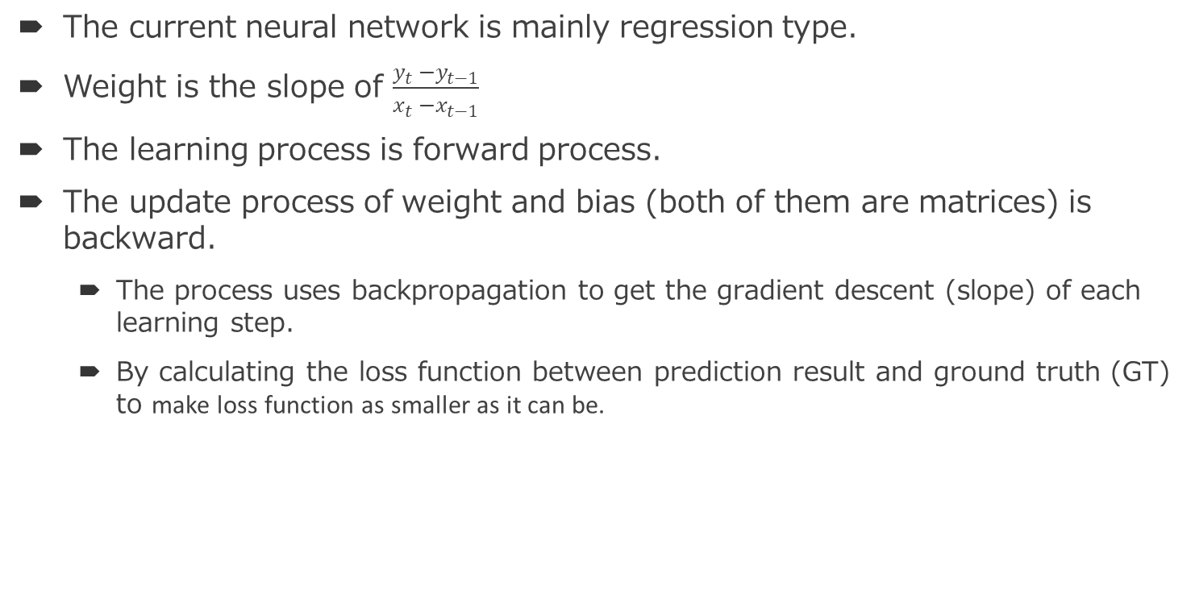
Wrap up
The current neural network is mainly regression type.
Weight is the slope of $\frac{y_{t} −y_{t−1}}{x_{t} −x_{t−1}}$
The learning process is forward process.
The update process of weight and bias (both of them are matrices) is backward.
The process uses backpropagation to get the gradient descent (slope) of each learning step.
By calculating the loss function between prediction result and ground truth (GT) to make loss function as smaller as it can be.
But if there is no GT?

Slide 10
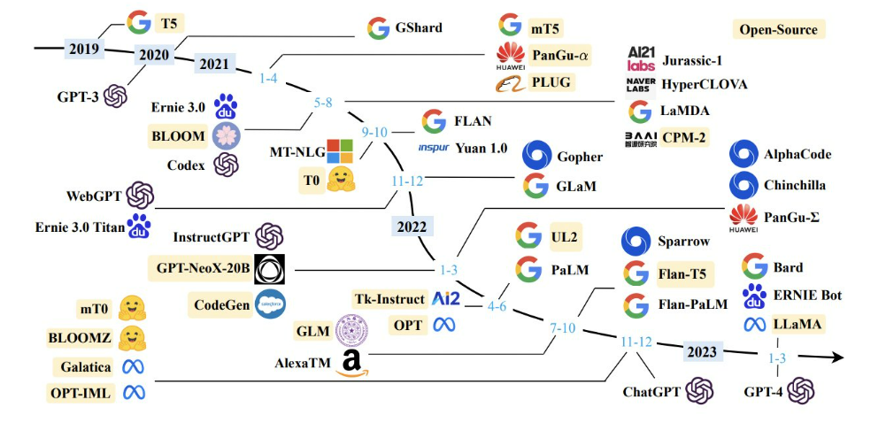
What is LLM?
A large language model (LLM) is a type of machine learning model designed for natural language processing tasks such as language generation. LLMs are language models with many parameters (weights, inputs, bias, outputs), and are trained with self-supervised learning on a vast amount of text.
BERT (2018) 340M)
Mamba, GPT-4o…
A timeline of existing large language models (having a size larger than 10B) until 2023/04
Source:
https://en.wikipedia.org/wiki/Large_language_model
https://www.nextbigfuture.com/2023/04/timeline-of-open-and-proprietary-large-language-models.html
https://github.com/Hannibal046/Awesome-LLM

Slide 11
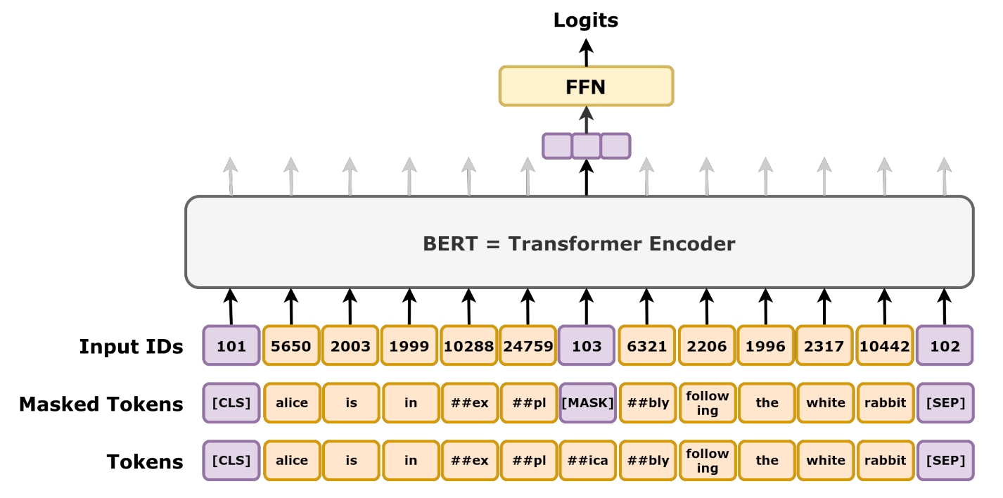
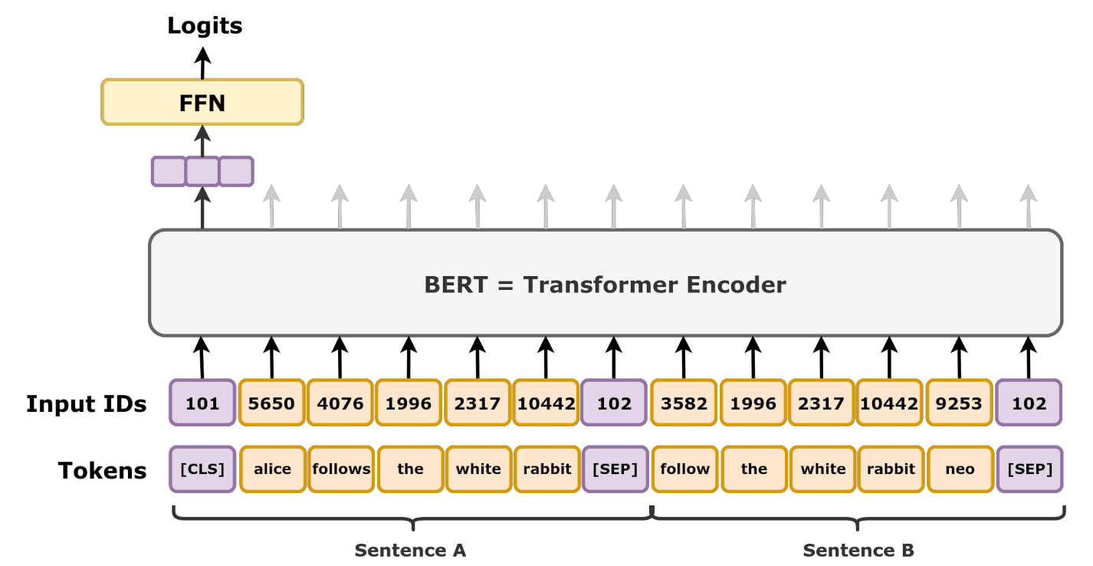
Self-supervised Learning
Self-supervised learning is a form of unsupervised learning where the system generates supervisory signals (supervisor) from the data itself. This is typically achieved through the creation of pretext tasks, which involve manipulating the input data and then training the model to predict the original data from these modifications. Common pretext tasks include:
Masked Language Modeling (MLM)
Next Sentence Prediction (NSP)
In masked language modeling, 15% of tokens would be randomly selected for masked-prediction task, and the training objective was to predict the masked token given its context. In more detail, the selected token is
・replaced with a [MASK] token with probability 80%,
・replaced with a random word token with probability 10%,
・not replaced with probability 10%.
For example, given "[CLS] my dog is cute [SEP] he likes playing" the model should output token [IsNext].
Given "[CLS] my dog is cute [SEP] how do magnets work" the model should output token [NotNext].
The next sentence prediction task.
The masked language modeling task.
Source:
https://www.goml.io/the-role-of-self-supervised-learning-in-llm-development/
https://en.wikipedia.org/wiki/BERT_(language_model)

Slide 12
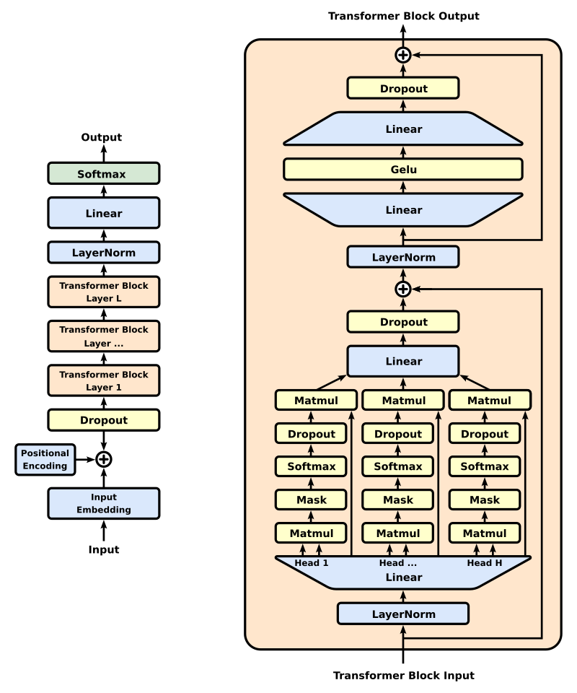
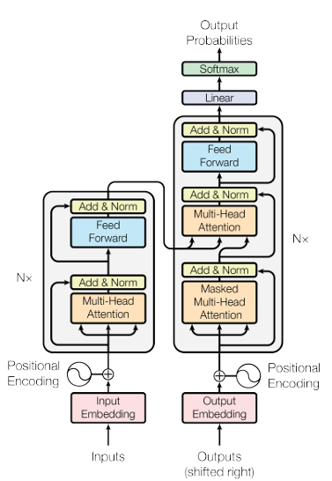
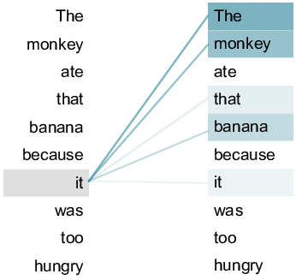
Transformer (Self-Attention), Generative pre-trained transformer (GPT)
The GPT-1 architecture was a twelve-layer decoder-only transformer, using twelve masked self-attention heads, with 64-dimensional states each (for a total of 768). Rather than simple stochastic gradient descent, the Adam optimization algorithm was used; the learning rate was increased linearly from zero over the first 2,000 updates to a maximum of 2.5×10−4
A standard Transformer architecture, showing on the left an encoder, and on the right a decoder.
Self-attention sentence example
Original GPT architecture
Source:
https://www.goml.io/the-role-of-self-supervised-learning-in-llm-development/
https://arxiv.org/abs/1706.03762 https://en.wikipedia.org/wiki/Transformer_(deep_learning_architecture)
https://www.researchgate.net/figure/An-example-of-the-self-attention-mechanism-following-long-distance-dependency-in-the_fig1_350714675
https://en.wikipedia.org/wiki/GPT-1

Slide 13
Wrap up
Even without GT, LLM still can use the self-supervised learning to predict the next output.
Self-attention can help find inter-sentence words/tokens how close they are.
GPT uses the decoder part of Transformer, by adding attention to generate the next word/token.

Slide 14
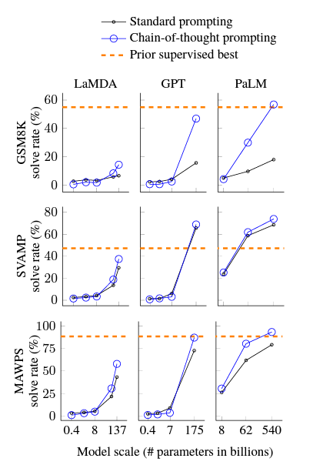
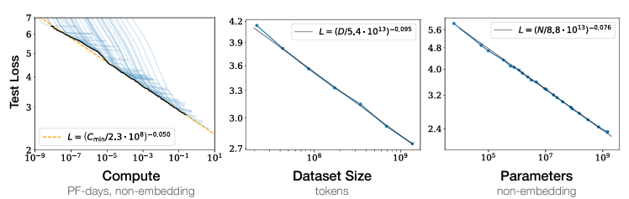
LLM Key Features - Scaling Laws
OpenAI in 2020, published a Scaling laws show Language modeling performance improves smoothly as the increasing of the model size, dataset size, and amount of compute used for training.
However, Google Research proposed Chain-of-Thought in 2022, showing that LLMs have challenges on solving more complex tasks, which need more reasoning.
OpenAI published a paper in 2020 by showing that Language modeling performance improves smoothly as the increasing of the model size, datasetset size, and amount of compute used for training.
Chain-of-thought prompting enables large language models to solve challenging math problems.
Source:
https://arxiv.org/abs/2001.08361
https://arxiv.org/abs/2201.11903

Slide 15
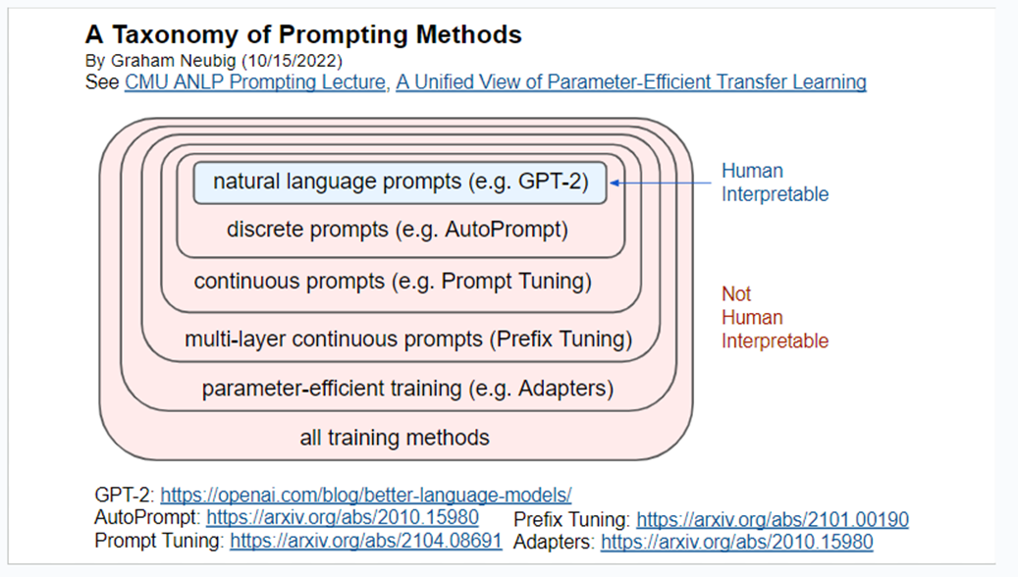
LLM Key Features -Prompt Engineering
Chain-of-Thought is a type of prompt engineering. Actually, there are many types of prompt engineering.
There re many prompting methods.
Source: https://docs.google.com/presentation/d/1YfSkqvFVtRkFBpQ4SKuBlqkhJrzWEERluivYjleB6a4/edit#slide=id.p

Slide 16
A taxonomy of prompting methods
Full fine-tuning (2018)
Fine-tune all the model parameters to adapt general-purpose PLMs to downstream tasks.
Per task, it is access to all the tasks datasets simultaneously.
Co-train the LM weights and top-layer weights.
Train 100% parameters efficient.
Parameter-efficient fine-tuning/training: Adapter tuning/Adapters (2019)
Add only a few trainable parameters per task, and new tasks can be added without revisiting previous ones. Train on tasks sequentially.
Inject new layers (only a small number of additional parameters per task) into the original network.
The weights of the original network are untouched, whilst the new adapter layers are initialized at random.
Train only about 3.6% parameters per task.
Prompting/prompt engineering (2020)
Human interpretable (textual) prompting/prompt engineering/prompt design/priming
In-context learning (GPT-3)
Instruction-tuning (is also a type of prompt-tuning)
Normal zero-shot, one-shot, few-shot prompting, etc.
Human uninterpretable (discrete, continuous, etc.) prompting/prompt engineering

Slide 17
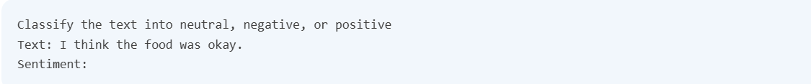
Elements of a Prompt
A prompt can contain information like the instruction or question you are passing to the model and include other details such as context, input (sometimes with examples), and output indicator .
Instruction - a specific task or instruction you want the model to perform
Context - external information or additional context that can steer the model to better responses
Input Data - the input or question that we are interested to find a response for
Output Indicator - the type or format of the output.
An example of prompt
Source: https://www.promptingguide.ai/introduction/elements

Slide 18
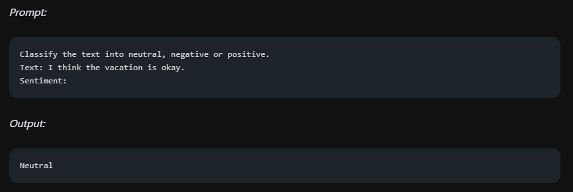
Zero-shot prompting example
E.g., there is no prompt example given to the model while doing classifications, however, the LLM already understands "sentiment" -- that's the zero-shot capabilities at work.
There is no prompt example
Figure 01: An example of zero-shot prompting
Source: https://www.promptingguide.ai/techniques/zeroshot

Slide 19
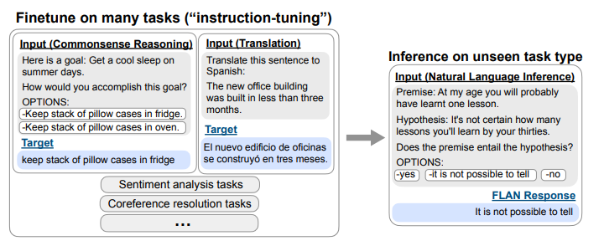
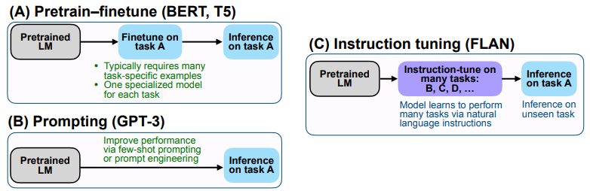
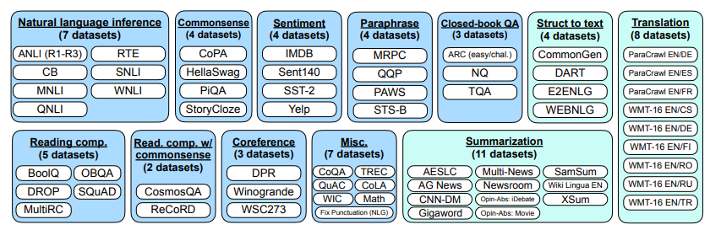
Instruction tuning for zero-shot prompting experiment
Dataset
Overview of instruction tuning and FLAN
Comparing instruction tuning with pretrain–finetune and prompting
Datasets and task clusters used in this paper (Natural Language Understanding tasks in blue; Natural Language Generation tasks in teal)

Slide 20
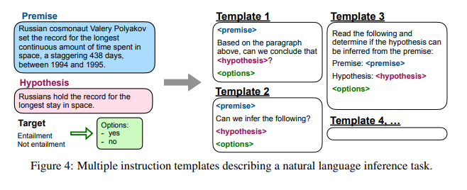
Unique templates as instruction
Unique template
For each dataset, the authors manually compose ten unique templates that use natural language instructions to increase diversity.
For each dataset they also include up to three templates that “turned the task around” (to increase the diversity of the task).

Slide 21
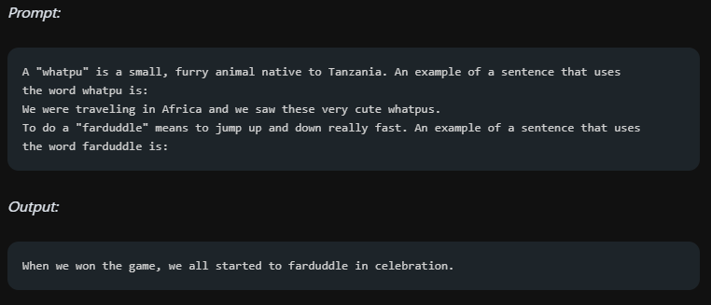
Few-shot prompting example
In the example, the task is to correctly use a new word in a sentence by providing a prompt example.
Prompt example
task/question
An example of few-shot prompting

Slide 22
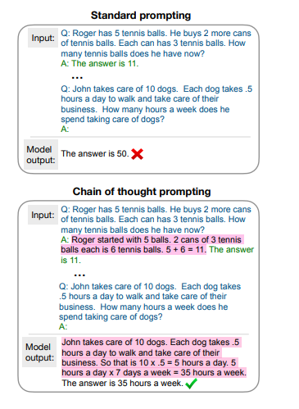
CoT prompting example
Few-shot prompt learning:
given a few exemplar prompts of Q and A sets directly.
(Not just the answer, but also please tell me the logic/reason/inference why you give this answer!)
Few-shot manual-CoT prompt learning:
Not just providing the exemplar prompts of Q and A sets, but also the CoT of A.
Chain of thought (highlighted) facilitates multistep reasoning in large language models. The output here is from a 137B parameter LaMDA language model.

Slide 23
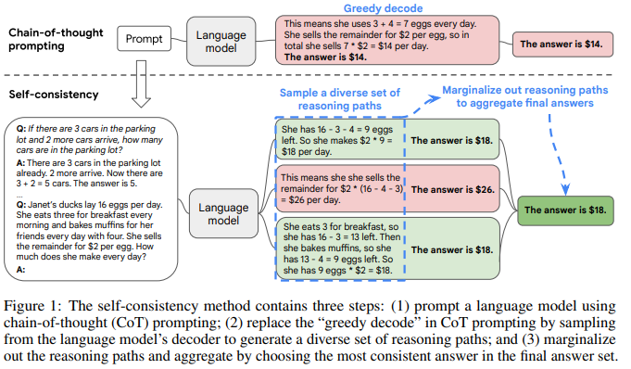
Self-consistency example
The comparison between CoT prompting and Self-consistency

Slide 24
Tips on Prompt Engineering
Use prompt engineering technical introduced in this slides in your prompt.
Zero-shot, Few-shot, CoT, self-consistency prompting
Adding a role into your prompt.
You are a Mathematical expert…
Decompose the question into small pieces for LLM to understand.
How to write ChatGPT prompt:
https://www.coursera.org/articles/how-to-write-chatgpt-prompts

Slide 25
Wrap up
Scaling law is not really the truth.
The prompt engineering commonly known is hard prompting.
Zero-shot prompting, zero-shot prompting, CoT prompting are the most commonly used hard prompt engineering methods.
All there of them are also called In-context learning (ICL).
ICL is a model's ability to adapt to input without changing its internal parameters, while few-shot prompting is a technique within ICL that uses examples to guide the model's behavior.
Self-consistency prompting aims to increase the trustworthiness and robustness of an LLM.

Slide 26
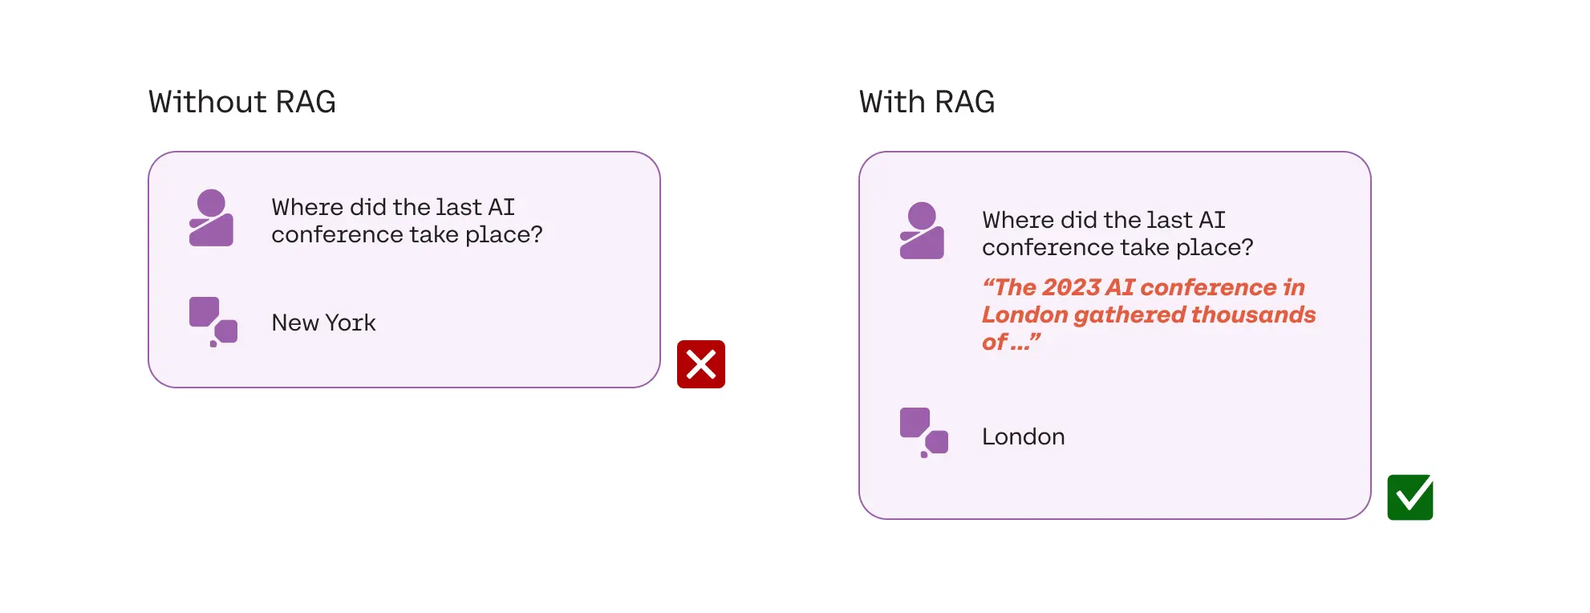
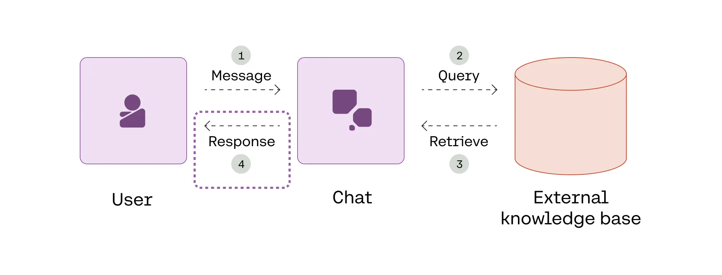
RAG
What RAG Adds
RAG
Reason: Normal LLM can not answer internal domain questions (e.g., company related information).
Technical: Relies on in-context learning: source material is included as part of the prompt when generating.
No model training (no parameter (weight, bias) update)
Use case: add knowledge to the model
How RAG works
Source: Introduction to RAG

Slide 27
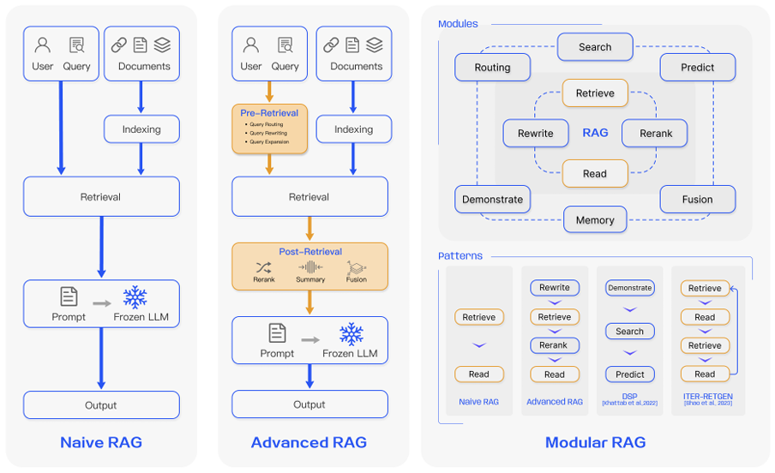
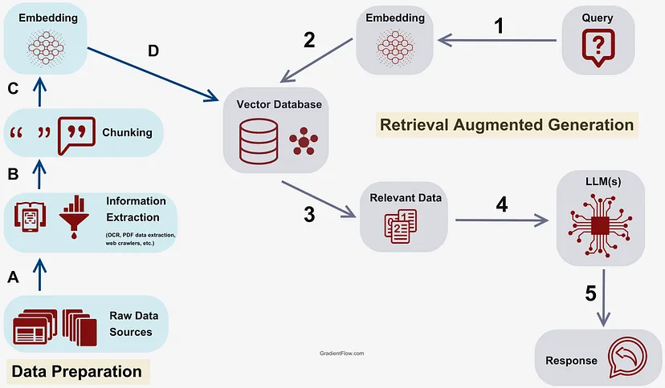
Details of RAG
The process of Naïve RAG
Comparison between the three paradigms of RAG. (Left) Naive RAG mainly consists of three parts: indexing, retrieval and generation. (Middle) Advanced RAG proposes multiple optimization strategies around pre-retrieval and post-retrieval, with a process similar to the Naive RAG, still following a chain-like structure. (Right) Modular RAG inherits and develops from the previous paradigm, showcasing greater flexibility overall. This is evident in the introduction of multiple specific functional modules and the replacement of existing modules. The overall process is not limited to sequential retrieval and generation; it includes methods such as iterative and adaptive retrieval.
Source:
https://gradientflow.com/techniques-challenges-and-future-of-augmented-language-models/
https://arxiv.org/abs/2312.10997

Slide 28
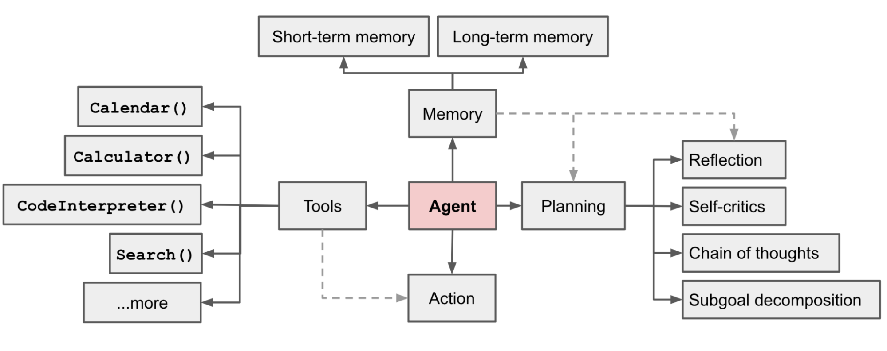
AI Agent
AI Agent
Reason: The question involves a complex problem, thus normal LLM can not solve the problem.
Technical: Relies on the tool-use of RAG: Let LLM to planning, use tools and take action by it self.
No model training (no parameter (weight, bias) update)
Use case: Plan and Use different tools to solve more complex problems
Overview of an LLM-powered autonomous agent system.
Source: https://lilianweng.github.io/posts/2023-06-23-agent/

Slide 29
Wrap-up
RAG is a special prompt engineering use LLM to retrieve internal-domain data.
AI Agent uses LLM to analysis the question, and decompose the question into several smaller problems. And each problem uses different tools. Each tool takes different action to help solve the problem. Memory is used to remember the previous actions and results to better help LLM make plans.

Slide 30
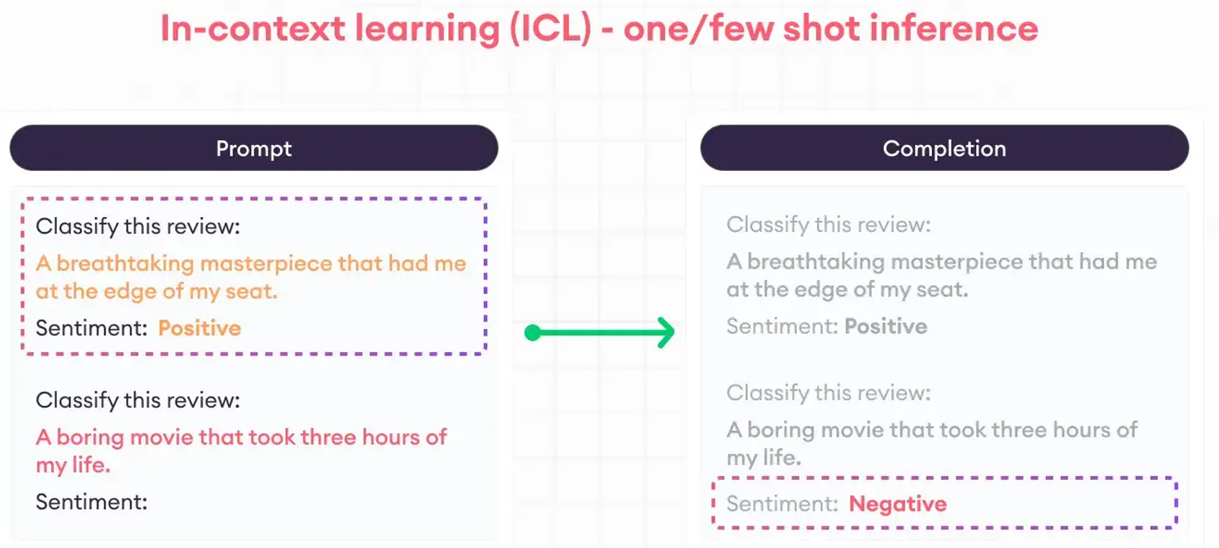
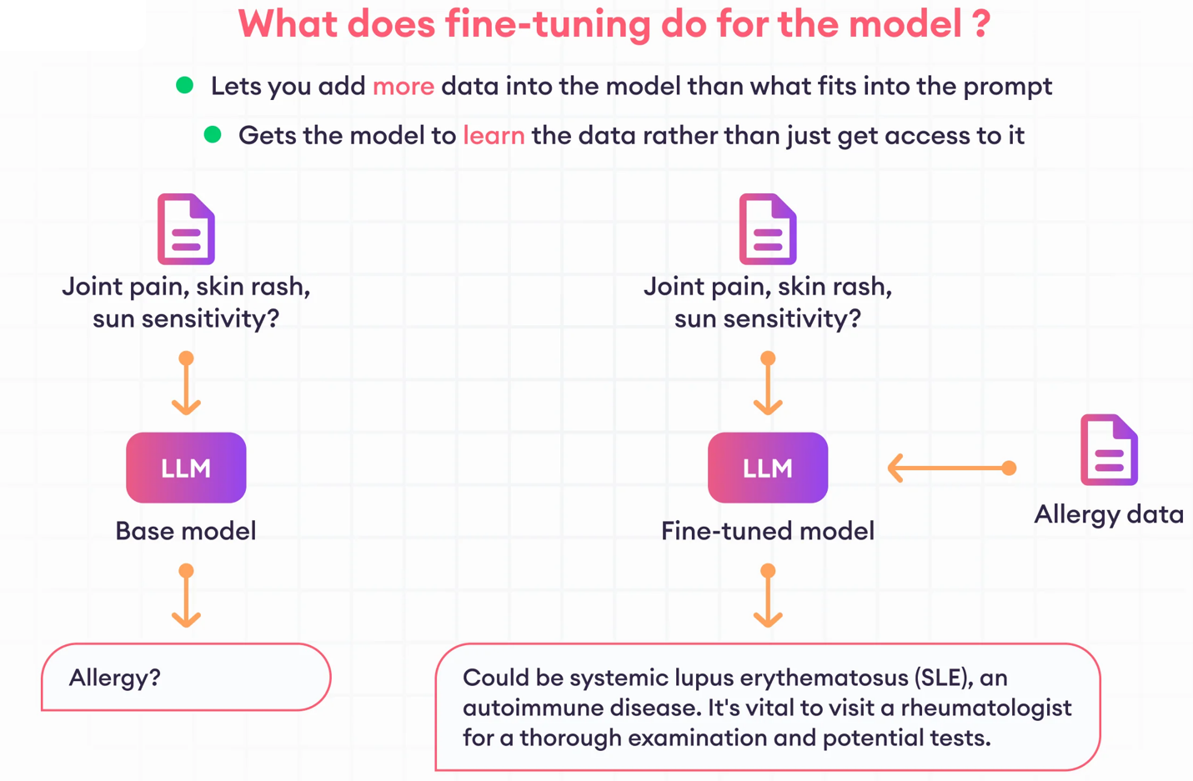
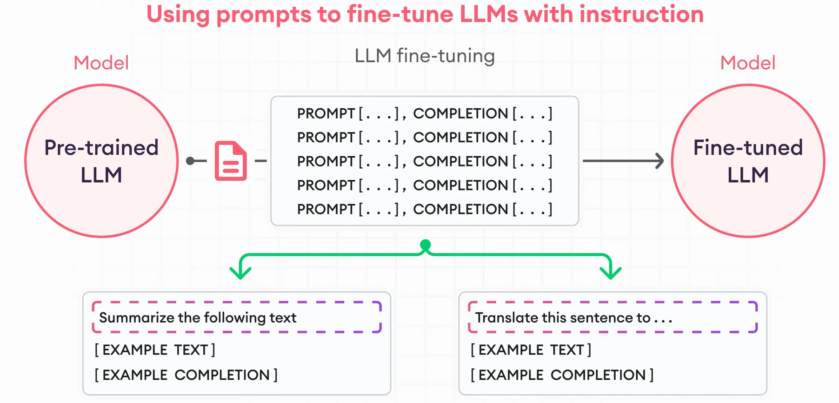
Fine-tuning
Usually, instruction tuning is used for fine-tuning an LLM.
An instruction data format
For the same question, the results comparison of using normal LLM and fine-tuned LLM.
The process of instruction tuning
Source: https://www.superannotate.com/blog/llm-fine-tuning

Slide 31
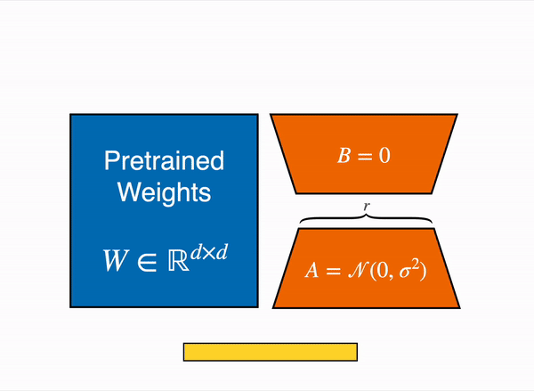
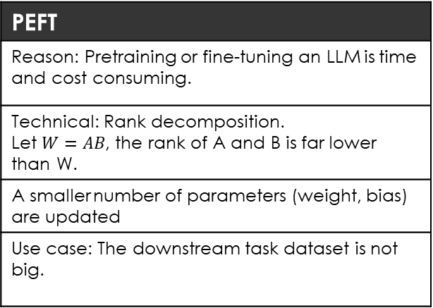
PEFT
The high cost of full-fine tuning has inspired researchers to develop cheaper approaches
LORA (Low Rank Adaptation) is representative of PEFT approaches: Train 2 matrices with lower rank than the original, but whose product yields the same rank as the original matrix
Fewer parameters means it’s cheaper to train, and cheaper to serve multiple PEFT models simultaneously
PEFT
Reason: Pretraining or fine-tuning an LLM is time and cost consuming.
Technical: Rank decomposition. Let $W=AB$, the rank of A and B is far lower than W.
A smaller number of parameters (weight, bias) are updated
Use case: The downstream task dataset is not big.
The technique constrains the rank of the update matrix ΔW using its rank decomposition. It represents ΔWₙₖ as the product of 2 low-rank matrices Bₙᵣ and Aᵣₖ where r << min(n, k). This implies that the forward pass of the layer, originally Wx, is modified to Wx + BAx (as shown in the figure below). A random Gaussian initialization is used for A and B is initially to 0, so BA=0 at the start of training. The update BA is additionally scaled with a factor α/r.
Source: https://arxiv.org/abs/2106.09685

Slide 32
Wrap up
Increasing complexity and cost
but increasing customizability
RAG
Retrieval Augmented Generation
No training
PEFT
Parameter Efficient Fine Tuning
Minimal training
SFT
Supervised Fine Tuning (especially, instruction tuning)
High level behavior: for specific domain or function (e.g., chat, healthcare...)
In-context learning
Minimal data
More data
* Approaches are not mutually exclusive

Slide 33
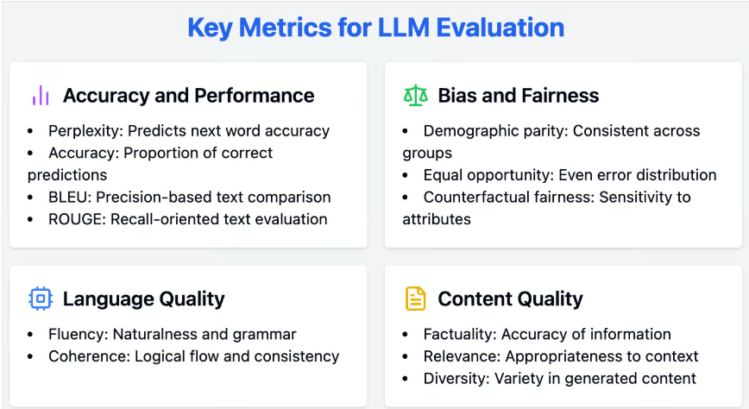
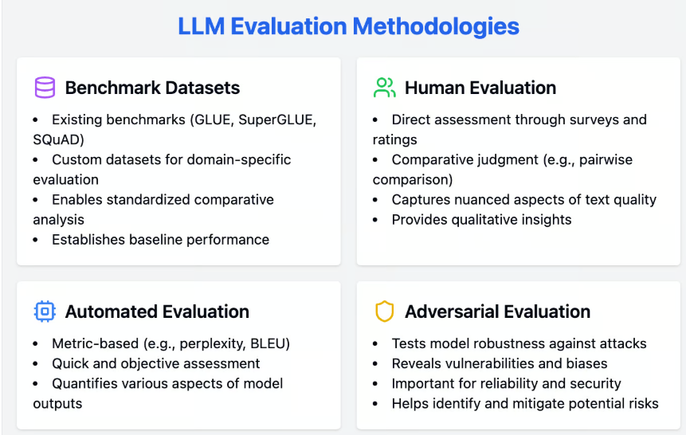
LLM Evaluation
The key points to evaluate an LLM
The key methods to evaluate an LLM
Attention: LLM evaluation is not RAG evaluation. They are different.

Slide 34
Wrap-up
LLM belongs to the IR4.0
Deep learning is a subfield of machine learning which uses artificial neural networks to enable artificial intelligence systems to learn complex patterns/regularities from data.
LLM’s learning method is self-supervised learning. Since it is regression machine learning, so it is also called as self-regression learning or auto-regression.
The current main architecture of LLMs is still transformer (self-attention).
Scaling law is not correct, when reaching some point of scaler, combining prompt engineering is necessary.
Zero-shot, few-shot, CoT, self-consistency, Role Prompting are commonly used prompting methods in our daily life.
Learning how to interact with LLM and decompose the question for LLM to understand are important.
RAG, AI Agent are the future main use-cases to use LLMs.
PEFT is more efficient while the training data size is small.
An LLM is evaluated through different perspectives using different metrics.

Slide 35
Thank you

